Slide 1
Study about Continued Use of LinkedIn
Q5 How much do you agree with the following statements about LinkedIn usage? (7-point scale)
All things considered, it is likely that I will continue to use LinkedIn (1)
I value the information LinkedIn offers, with the help of which I get what I need in a certain situation (2)
Using LinkedIn helps me to feel accepted by others (3)
LinkedIn properly satisfies users’ needs (4)
LinkedIn is part of my everyday activity (5)
I would be upset if LinkedIn shut down (6)
I rely on LinkedIn when I have a specific information need (7)
LinkedIn provides convenient functions (8)
Using LinkedIn bores me (9)
How likely is a person to stop using LinkedIn?

Slide 2
Random Forests
A decision tree model
An ensemble method - To make predictions based on the predictions of a group of the individual trees, each of which on a different random subset of the training set.
One of the most powerful Machine Learning algorithms available.

Slide 3
Training data
Data Sample 2
…
Data Sample 1
Data Sample N
…
Feature Sample 1
Feature Sample 2
Feature Sample N
Tree 1
Tree 2
Tree N
Prediction 1
Prediction 2
Prediction N
Random Forests Prediction: average prediction

Slide 4
Random Forests
Voting Classifiers
Hard voting classifier: aggregate the predictions of each classifier and predict the class that gets the most votes.
This majority-vote classifier is called a hard voting classifier.
Higher accuracy than the best classifier in the ensemble
Soft voting classifier: predict the class with the highest-class probability, averaged over all the individual classifiers.
Bagging and Pasting
When sampling is performed with replacement, this method is called bagging (short for bootstrap aggregating).
When sampling is performed without replacement, it is called pasting.

Slide 5
Identifying Soccer Players on Facebook through Predictive Analytics
Bogaert et al. (2017), Decision Analysis
https://pubsonline.informs.org/doi/10.1287/deca.2017.0354
Develop a system to support marketers with the decision as to which prospects to target for advertising purpose
Using several ML methods including Random forest and logistic regression
Prediction performance varies from 81.96% to 83.95% for accuracy
The most important features/variables:
The average number of friends that play soccer
Membership of a soccer group
The number of favorite teams

Slide 6
Run Random Forests in Python
from sklearn.ensemble import RandomForestClassifier
rnd = RandomForestClassifier(n_estimators=500, max_leaf_nodes=16, n_jobs=-1, random_state=21)
rnd.fit(x_train, y_train)
y_pred = rnd.predict(x_test)
Hyperparamters
The n_estimators hyperparameters controls how many individual decision trees will be built
Max_leaf_nodes: maximal number of leaf nodes which can be grown
Extremely Randomized Trees (Extra trees)
A forest of extremely random trees being selected using random thresholds for each feature rather than searching for the best possible thresholds (like regular Decision Trees do).
from sklearn.ensemble import ExtraTreesClassifier
rnd = ExtraTreesClassifier(n_estimators=500, max_leaf_nodes=16, n_jobs=-1, random_state =21)
rnd.fit(X_train, y_train)
y_pred = rnd.predict(X_test)

Slide 7
Random Forests
 | Feature importance
Q5_2 | 0.221445
Q5_3 | 0.071668
Q5_4 | 0.114795
Q5_5 | 0.232877
Q5_6 | 0.064925
Q5_7 | 0.077191
Q5_8 | 0.139245
Q5_9 | 0.077854
Logit model coefficients
0.960953
-0.02877
0.219149
0.030241
0.010556
-0.29359
0.655277
0.156657
Feature Importance
Measuring how much the tree nodes that use that feature reduce impurity on average (across all trees in the forest).
A weighted average, where each node’s weight is equal to the number of training samples that are associated with it
print(rnd.feature_importances_)

Slide 8
Model Performance Measures
Error rate (accuracy)
The proportion of incorrect (/correct) classifications for all the cases
Precision
The model’s ability to correctly predict the positives out of all the positive prediction it made
True positives/(True positives + False positives)
Sensitivity
The proportion of the positive class got correctly classified
True positives/(True positives + False negatives)
Specificity
The proportion of the negative class got correctly classified
True negatives/(True negatives + False positives)
AUC-ROC
The higher the AUC, the better the performance of the model at distinguishing between the positive and negative classes (0 ~ 1, the higher the better)
Cross-entropy
A measure of the difference between two probability distributions for a given random variable or set of events (the lower the better)

Slide 9




Confusion Matrix
All possible mistakes a classification model can make
 | Predicted Class
Actual Class |  | Class=No | Class=Yes
 | Class=No | True Negative | False Positive
 | Class=Yes | False Negative | True Positive
$Specificity=\frac{True Negative}{True Negative+False Positive}$
$Sensitivity=\frac{True Positive}{True Positive+False Negative}$
$Precision=\frac{True Positive}{True Positive+False Positive}$
$Error rate=\frac{False Negative+False Positive}{Total cases}$

Slide 10
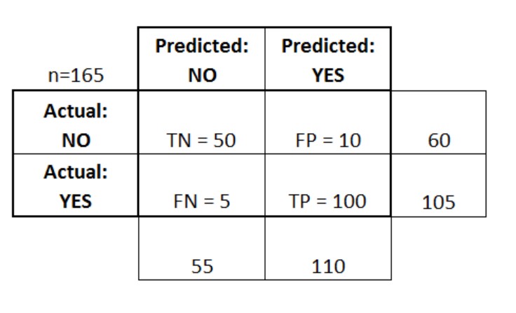
An Exercise

Slide 11
Answer Key
Accuracy
Error Rate:
Sensitivity:
Precision:
Specificity:

Slide 12


Model Performance Measures
from sklearn.metrics import accuracy_score, precision_score, confusion_matrix
from sklearn.metrics import, roc_auc_score, log_loss
import pandas as pd
columns=['Error rate', 'Precision', 'Sensitivity', 'Specificity', 'AUC', 'Cross-Entropy']
rows=[‘Random Forest']
results=pd.DataFrame(0.0, columns=columns, index=rows)
y_pred = rnd.predict(x_test)
y_prob = rnd.predict_proba(x_test)[:,1]
results.iloc[0,0]= 1 - accuracy_score(y_test, y_pred)
results.iloc[0,1]= precision_score(y_test, y_pred)
confusion = confusion_matrix(y_test, y_pred)
results.iloc[0,2]= confusion[1,1]/np.sum(confusion[1,:])
results.iloc[0,3]= confusion[0,0]/np.sum(confusion[0,:])
results.iloc[0, 4]= roc_auc_score(y_test, y_prob)
results.iloc[0, 5]= log_loss(y_test, y_prob)
results
$Sensitivity=\frac{True Positive}{True Positive+False Negative}$
$Specificity=\frac{True Negative}{True Negative+False Positive}$

Slide 13
Predicated DV
Respondent | y_test | y_pred
1 | 1 | 0
2 | 1 | 0
3 | 1 | 1
4 | 0 | 0
5 | 1 | 0
6 | 0 | 1
7 | 0 | 0
8 | 1 | 1
9 | 0 | 0
10 | 0 | 0
11 | 1 | 1
12 | 0 | 0
13 | 0 | 1
14 | 0 | 1
15 | 0 | 0
16 | 1 | 1
17 | 0 | 1
18 | 1 | 1
19 | 0 | 0
20 | 0 | 1
21 | 1 | 0
22 | 0 | 0
23 | 0 | 0

Slide 14
Model Performance Measures
 | Error rate | Precision | Sensitivity | Specificity | AUC | Cross-Entropy
Random Forest | 0.214286 | 0.733333 | 0.825 | 0.758621 | 0.9075 | 0.414877

Slide 15
Random Forests: Multi-class DV
Respondent | y_test | y_pred
1 | 7 | 5
2 | 7 | 7
3 | 7 | 7
4 | 6 | 6
5 | 7 | 7
6 | 6 | 7
7 | 4 | 5
8 | 7 | 7
9 | 5 | 5
10 | 5 | 6
11 | 7 | 7
12 | 5 | 5
13 | 4 | 5
14 | 6 | 7
15 | 5 | 5
16 | 7 | 7
17 | 6 | 7
18 | 7 | 7
19 | 6 | 5
20 | 6 | 7
21 | 7 | 7
22 | 6 | 6
23 | 5 | 6
Run the same codes with multi-class DV
y.value_counts()
7 126
6 73
5 57
4 22
3 2
from sklearn.ensemble import RandomForestClassifier
rnd = RandomForestClassifier(n_estimators=500, max_leaf_nodes=16, n_jobs=-1, random_state=21)
rnd.fit(x_train, y_train)
y_pred=rnd.predict(x_test)

Slide 16
Random Forests – Continuous DV
Respondent | y_test | y_pred | y_pred_continuous
1 | 7 | 5 | 4.994999
2 | 7 | 7 | 5.862776
3 | 7 | 7 | 6.609993
4 | 6 | 6 | 5.614799
5 | 7 | 7 | 6.820223
6 | 6 | 7 | 6.649467
7 | 4 | 5 | 4.657991
8 | 7 | 7 | 6.826157
9 | 5 | 5 | 4.681163
10 | 5 | 6 | 5.410153
11 | 7 | 7 | 6.699634
12 | 5 | 5 | 4.574776
13 | 4 | 5 | 5.891488
14 | 6 | 7 | 6.70538
15 | 5 | 5 | 4.976296
16 | 7 | 7 | 6.71917
17 | 6 | 7 | 6.545537
18 | 7 | 7 | 6.830737
19 | 6 | 5 | 4.899143
20 | 6 | 7 | 6.316029
21 | 7 | 7 | 6.636469
22 | 6 | 6 | 5.91422
23 | 5 | 6 | 5.839056
Use RandomeForestRegressor
from sklearn.ensemble import RandomForestRegressor
rnd_reg = RandomForestRegressor(n_estimators=500, max_leaf_nodes=16, n_jobs=-1)
rnd_reg.fit(x_train, y_train)
y_pred = rnd_reg.predict(x_test)

Slide 17
Random Forests
Pros
Cons
Categorical or continuous target variable
Interested in importance of predictors
Need a quick benchmark model
If you have messy data, such as missing values, outliers
If you’re solving a very complex, novel problem
Transparency is important
Prediction time is important

Slide 18
Logistic Regression vs. Random Forests
Logistic
Random Forest
Want to know the impact of a feature on DV (positive/negative)
Statistical significance is important
Continuous target variable
Prediction is the focus rather than the impact of a particular feature
Fine with ‘black’ boxes
Messy data

Slide 19
Causal Forest – Causal Machine Learning
Athey and Wager (2019)
Tackle the ‘black’ box issue by estimating the causal effect
Study the mindset intervention effective in improving student achievement
76 schools (with 10, 391) were split into experiment group and control group
Control for the treatment effect heterogeneity.
A treatment can be exposure to an ad, a discount, or social media site (e.g., Facebook fan page)
To check the impact of a treatment, usually we randomly assign people to treatment group (with exposure to the treatment) and control group (without exposure to the treatment and then check the two groups’ difference in outcomes
However, the groups might have differences themselves. How to deal with it?

Slide 20
Boosting
A decision tree model
Any ensemble method that can combine several weak learners into a strong learner.
Specifically, to train predictors sequentially, each trying to correct its predecessor.

Slide 21
Training data
Data Sample 1
Data Sample 2
Feature Sample 1
Data Sample N
Feature Sample 2
Feature Sample N
…
…
Overweight misclassified examples
Overweight misclassified examples
Prediction 1
Prediction 2
Prediction N
Boosting Prediction:
Weighted average prediction

Slide 22
Boosting Methods
AdaBoost (Adaptive Boosting)
In AdaBoost, a new predictor to correct its predecessor is to pay a bit more attention to the training instances that the predecessor underfitted. This results in new predictors focusing more and more on the hard cases.
Gradient Boosting
Instead of tweaking the instance weights at every iteration like AdaBoost does, this method tries to fit the new predictor to the residual errors made by the previous predictor.
from sklearn.ensemble import AdaBoostClassifier
ada_clf = AdaBoostClassifier(n_estimators=200, algorithm="SAMME.R", learning_rate=0.5)
ada_clf.fit(x_train, y_train)

Slide 23

Boosting Classification Trees to Predict Customer Churn
Lemmens and Croux 2006, Journal of Marketing Research
https://journals.sagepub.com/doi/10.1509/jmkr.43.2.276
The database contains the mature subscribers (i.e., customers who had been with the company for at least six months) to a major U.S. wireless telecommunications carrier
Predict whether a subscriber churns during the period of 31–60 days after the sampling date
Boosting performs substantially better than a binary logit model

Slide 24
Extreme Gradient Boosting - XGBoost
A popular gradient boosting library from Kaggle
Install it:
Run it in Python
pip install xgboost
from xgboost import XGBClassifier
XGB_clf = XGBClassifier(n_estimators=200, learning_rate=0.5)
XGB_clf.fit(x_train, y_train)

Slide 25
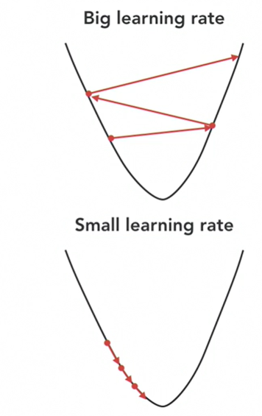
Boosting Hyperparameter
Learning rate:
Facilitating both how quickly and whether or not the algorithm will find the optimal solution

Slide 26
Boosting
Pros
Cons
Categorical or continuous target variable
Useful on nearly any type of problem
Interested in importance of predictors
Transparency is important
Training time is important or computing power is limited
Data is really noisy

